Slide 1


NextHikes IT Solutions: Sales Forecasting
Welcome to the NextHikes IT Solutions presentation on sales forecasting for Rossmann Pharmaceuticals. We aim to predict sales across multiple retail stores. This project will deliver an end-to-end prediction product.
by Kuldeep Singh

Slide 2

Project Overview: Sales Forecasting
Business Need
Key Factors
Our Goal
Forecast sales for Rossmann Pharmaceuticals stores six weeks ahead. This will help the finance team and managers.
Promotions, competition, holidays, seasonality, and locality influence sales predictions.
Build and deploy an end-to-end product for sales prediction. It will deliver insights to analysts.

Slide 3

Understanding the Data
The dataset includes various fields crucial for sales forecasting. Key identifiers are Store ID and Date.
Sales and Customer counts are direct metrics. Store status (Open) and holiday types (StateHoliday, SchoolHoliday) are also included.
Store Details
Competition & Promos
StoreType and Assortment describe store models and product variety.
CompetitionDistance and Promo indicators (Promo, Promo2) are vital features.

Slide 4




Learning Outcomes & Skills
Technical Skills
Gain expertise in Pandas, Matplotlib, Numpy, HTML, CSS, and Flask. Improve code modularization.
Predictive Pipeline
Master EDA, data wrangling, model building, and fine-tuning. Learn MLOps techniques.
Deployment
Learn to serve predictions via a web application. Understand end-to-end product delivery.

Slide 5
Weekly Badge Recognition
Each week, top performers earn badges and 20 points. This rewards diverse Machine Learning Engineering expertise.
Visualization
Recognizes quality, understandability, and choice of plots.
Code Quality
Focuses on reliability, maintainability, efficiency, and commenting.
Innovative Approach
Awards use of latest algorithms and research content.
Writing & Presentation
Celebrates clarity of outputs and overall production value.
Community Support
Honors helping others, sharing links, and tutoring.

Slide 6

Late Submission Policy
Our goal is to prepare successful learners. Timely submissions are expected.
Late submissions will impact grades. Plan accordingly to avoid penalties.
Interim Submissions
Final Submissions
1-6 hours late: max 50% grade. >6 hours late: feedback only, no grade.
1-24 hours late: max 50% grade. >24 hours late: feedback only, no grade.

Slide 7

Task 1: Customer Behavior Exploration
Exploratory Data Analysis (EDA) is crucial. It helps understand data nature and guides modeling.
Data Cleaning
Build pipelines to detect and handle outliers and missing data.
Visualizing Findings
Use plots and summary tables to communicate insights effectively. Answer key questions.
Key Questions
Analyze promo distribution, sales behavior during holidays, and customer trends.

Slide 8
Task 2: Store Sales Prediction
The central task is predicting daily sales up to six weeks ahead. This enables better company planning.
Preprocessing
Convert non-numeric data, handle NaNs, and generate new features.
Model Building
Use sklearn pipelines and tree-based algorithms like Random Forests.
Loss Function
Choose and defend an interpretable loss function for the model.
Post-Prediction Analysis
Explore feature importance and estimate prediction confidence intervals.
Model Serialization
Save models with timestamps for tracking daily predictions.

Slide 9

Deep Learning & MLFlow
Implement a Deep Learning model and use MLFlow for serving predictions.
LSTM Model
Build a two-layer Long Short Term Memory (LSTM) regression model.
Time Series Data
Isolate, check stationarity, and transform data for supervised learning.
MLFlow Inference
Utilize MLFlow code snippets for inference on test data.

Slide 10
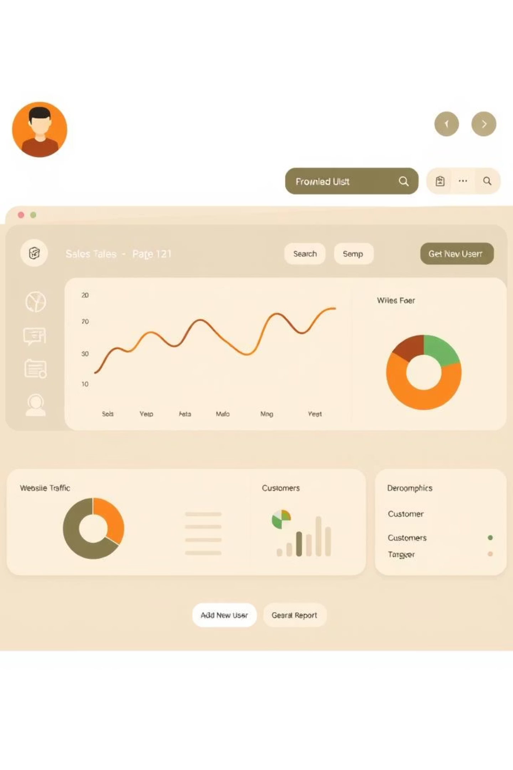



Task 3: Web Interface & Hosting
Design and build a web interface for sales prediction. Deploy the application.
Dashboard Design
Prediction Visualization
Create an intuitive frontend for managers to input parameters and view predictions.
Show predicted sales and customer numbers via plots. Allow CSV download.
Application Hosting
Deploy the web application on platforms like Heroku. Submit the link.

